Slide 1
Unlock Blockchain Value: From Your Four Walls to Trusted Partners to Connected Business Ecosystems — Praveen Jayachandran IBM Research - India
Notes:
Kick off blockchain track
Lot of hype and lot of misunderstanding
Confusion between cryptocurrencies in a public permissionless world and distributed ledgers for enterprises
Hopefully you will leave with a sense of reality at the end of the day. What are clients really working on?
What are the core problems being addressed? What is the value proposition? How do you go about building your network to address a business problem?
What are some of the technological challenges? How do you secure your network? How do you keep your organization’s data private and control who has access to what information?
These are some of the questions and answers we will give you a glimpse of today.
Organizations are working in silos…
We want to change that. We want to build business networks with a shared and trusted notion of truth. Not just about distributed ledgers or consensus… it’s the fact that you can create networks with people who want to do business with one another, who are permissioned and have trusted access to the network,
We want organizations to be able to collaborate together in an ecosystem, share data and processes in a trusted manner, with greater visibility, improved automation and fewer discrepancies and improved compliance to business and regulatory policies
Core requirements…

Slide 2

Blockchain is creating extraordinary opportunities for businesses to come together in new ways
Optimize Ecosystems
Streamline business processes and the exchange of value along your ecosystem
Reduce Risk
Replace uncertainty with transparency and a trusted decentralized ledger
Create New Value
Exploit new business models and eliminate inefficiencies
With a focus on
Security and Privacy
Compliance
Governance
Scalability

Slide 3

Business Ecosystems and Shared Truth
Point-to-point connections
Manual processes
Lack of trusted information
Trusted Partners
Digitization, Automation
Siloed information
Business Ecosystems
Transparency
Trusted information

Slide 4
Blockchain’s 3 Core Design Principles
Open by Design
No one (and everyone) controls the blockchain
Strive Towards Network-of-Networks
Blockchain Anywhere!
Notes:
Open source, open governance, policies and transparency on those; not just transparency of data and transactions on the network
Goods, data and value network-of-networks

Slide 5
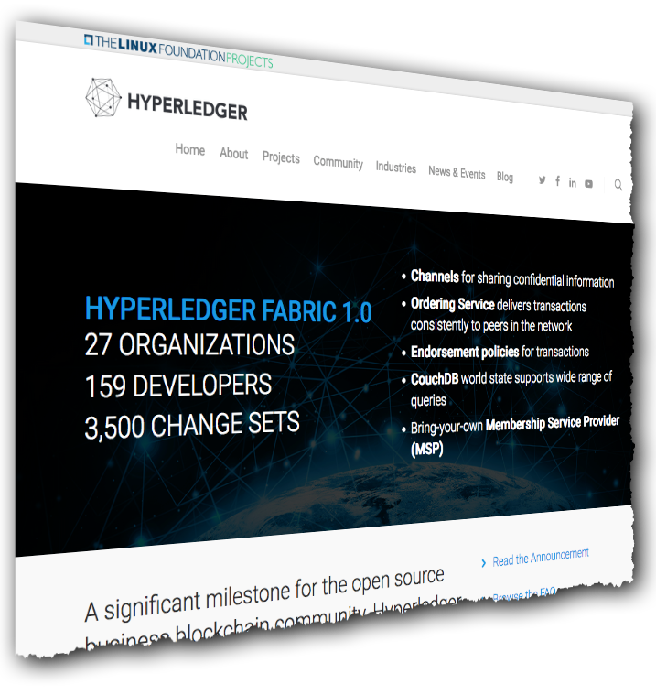
Hyperledger Fabric: Distributed ledger platform
Hyperledger: A Linux Foundation Project
A collaborative effort created to advance cross-industry blockchain technologies for business
An implementation of blockchain technology that is a foundation for developing blockchain applications
Emphasis on ledger, smart contracts, consensus, confidentiality, resiliency and scalability.
V1.0 released July 2017
159 developers from 27 organizations
IBM is one contributor of code, IP and development effort to Hyperledger Fabric
http://hyperledger-fabric.readthedocs.io/
Notes:
Demos and workshops happening
Varun Ojha will talk about what makes a good blockchain use case, how to go about developing one
Cateina Technologies talk about best practices in building applications using Hyperledger Fabric

Slide 6
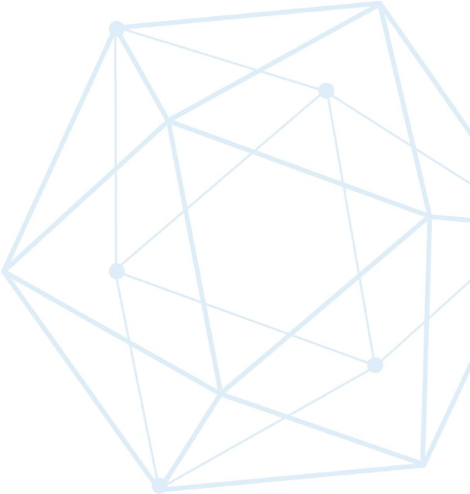
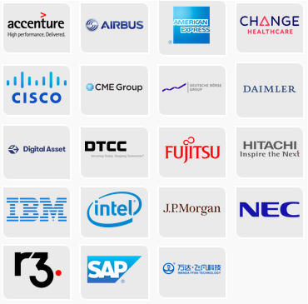
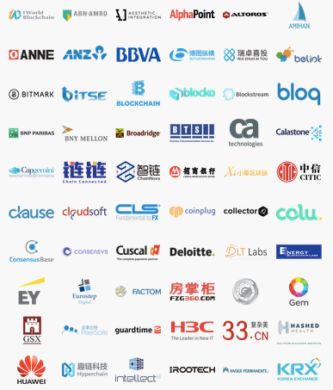
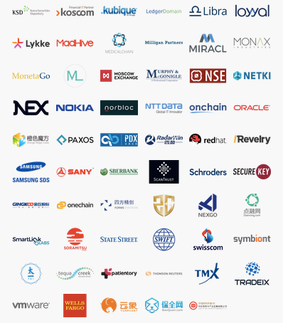
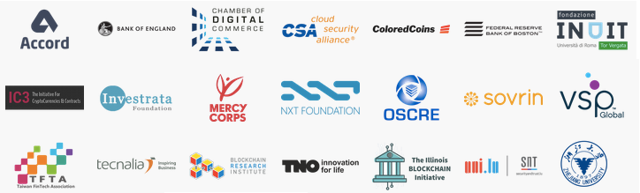
Hyperledger Members
Premier
General
Source: https://www.hyperledger.org/members
Updated 4 October 2017
Associate
Notes:
Hyperledger is the fastest growing project in Linux Foundation history and has a huge amount of industry support.

Slide 7
Gartner Blockchain Spectrum Model Forecast
Source: Gartner (December 2018)
Crawl Phase
Point solutions for specific use cases
Existing business process mapped to blockchain
Small scale, limited RoI
Walk Phase
Hybrid network deployments
Scale out industry-wide solutions
Network of networks
Run Phase
Business process transformation
Blockchain will combine with other technologies such as AI and IoT to drive value
Notes:
Crawl Phase – Balaji will talk through some existing networks that are running in production with real data
[[;

Slide 8
Technical Challenges
How do you build blockchain systems that are secure by design?
How do you keep your data private and yet share information in a verifiable manner with others?

Slide 9
Thank you!
Praveen Jayachandran
Senior Technical Staff Member and Master Inventor
IBM Research - India
—
praveen.j@in.ibm.com

